Slide 1
Deja vu
Enrollment No: 2205030201016
Name: DEVANI SHANIKUMAR RAJESHBHAI

Slide 2
Introduction
Have you ever had the sense that you’ve done something or gone through a new situation before? Does it seem like you know what’s going to happen next? That feeling is often described as déjà vu.
The saying comes from French, meaning "already seen."

Slide 3
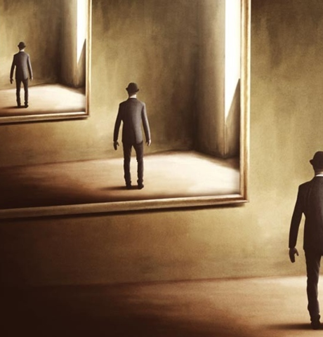
Who Experiences Déjà Vu?
Around 60% to 70% of people in good health experience some form of déjà vu during their lifetime.
Déjà vu happens most often to people between 15 and 25 years of age.
If you travel a lot or regularly remember your dreams, you may be more likely to experience déjà vu than others.
Most people have the experience during the evenings or on the weekends.
Example: You may walk into a room in a building you’ve never visited yet feel like you know it intimately.
Most feelings of déjà vu disappear quickly, which can make it hard for you to recall specific details about the experience.

Slide 4
What causes déjà vu to happen?
You may not be a magician, but when you experience déjà vu, your brain is creating an illusion.
This is thought to happen when there’s a bit of a miscommunication between two parts of your brain.
“Déjà vu is caused by dysfunctional connections between the parts of your brain that play a role in memory recollection and familiarity.”

Slide 5
conclusion
déjà vu might be the result of the brain trying to resolve an error between what you think you have seen before and what you are actually seeing.

